Slide 1

MATH30-6
Probability and Statistics

Slide 2
Reliability Applications
Reliability theory is concerned with the duration of the useful life of components and systems of components. That is, it is concerned with determining that a system with possibly many components will be functioning at time t. The components of a system can arranged in two basic configurations: series configuration and parallel configuration. A real system consists of a mixture of series and parallel components, which can sometimes be reduced to an equivalent system of series configuration or a system of parallel configuration.

Slide 3
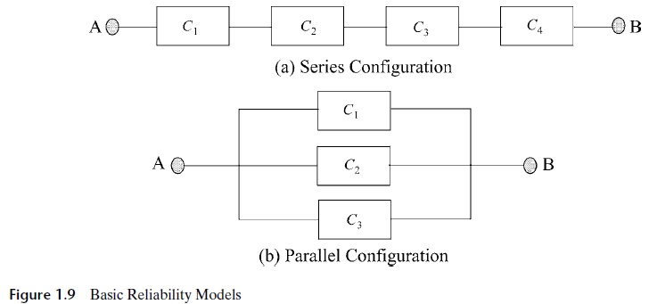
Reliability Applications
A system with series configuration will function if and only if all its components are functioning, while a system with parallel configuration will function if and only if at least one of the components is functioning. Different components fail independently.

Slide 4
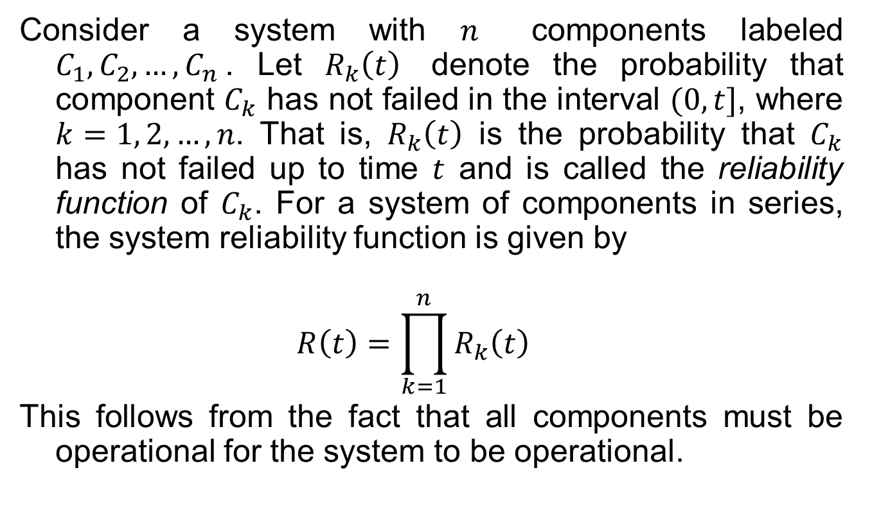
Reliability Applications
Consider a system with $n$ components labeled $C_{1}, C_{2},…, C_{n}$. Let $R_{k}\left(t\right)$ denote the probability that component $C_{k}$ has not failed in the interval $(0, t]$, where $k=1, 2, …, n$. That is, $R_{k}\left(t\right)$ is the probability that $C_{k}$ has not failed up to time $t$ and is called the reliability function of $C_{k}$. For a system of components in series, the system reliability function is given by
$$R\left(t\right)=\prod_{k=1}^{n}{R_{k}\left(t\right)}$$
This follows from the fact that all components must be operational for the system to be operational.

Slide 5
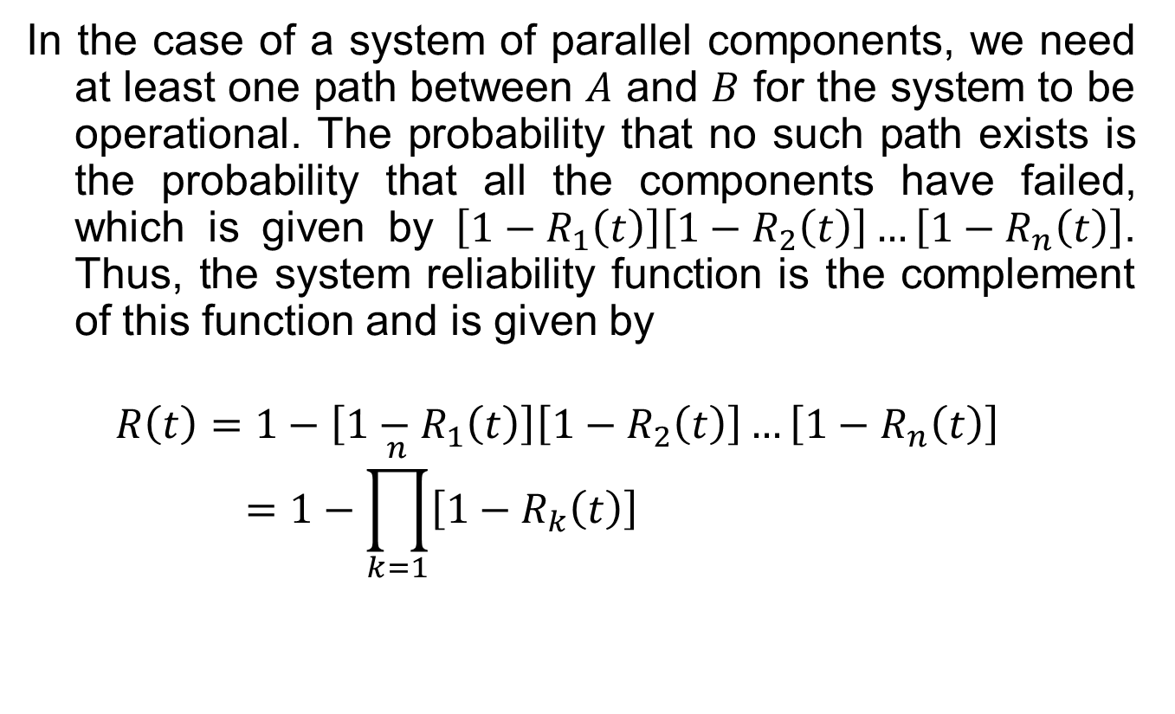
Reliability Applications
In the case of a system of parallel components, we need at least one path between $A$ and $B$ for the system to be operational. The probability that no such path exists is the probability that all the components have failed, which is given by $\left[1−R_{1}\left(t\right)\right]\left[1−R_{2}\left(t\right)\right]…\left[1−R_{n}\left(t\right)\right]$. Thus, the system reliability function is the complement of this function and is given by
$$R\left(t\right)=1−\left[1−R_{1}\left(t\right)\right]\left[1−R_{2}\left(t\right)\right]…\left[1−R_{n}\left(t\right)\right]=1−\prod_{k=1}^{n}{\left[1−R_{k}\left(t\right)\right]}$$

Slide 6
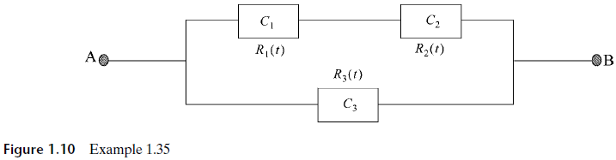

Examples
1.35 Find the system reliability function for the system shown in Figure 1.10 in which $C_{1}$ and $C_{2}$ are in series and the two are in parallel with $C_{3}$.

Slide 7
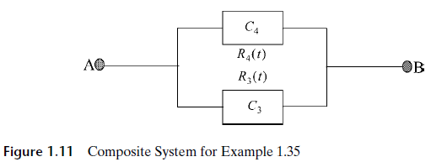
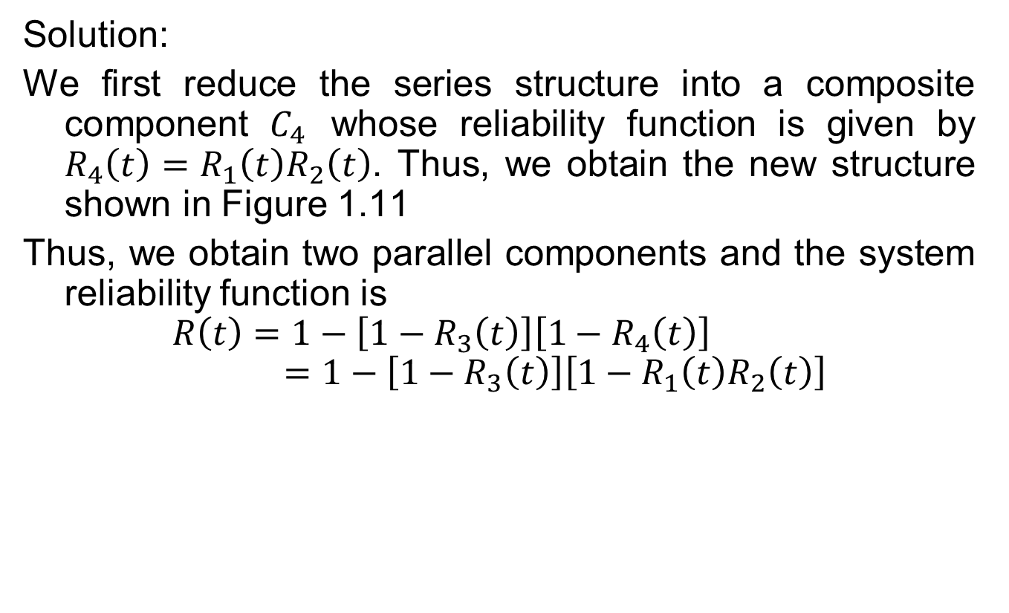
Examples
Solution:
We first reduce the series structure into a composite component $C_{4}$ whose reliability function is given by $R_{4}\left(t\right)=R_{1}\left(t\right)R_{2}\left(t\right)$. Thus, we obtain the new structure shown in Figure 1.11
Thus, we obtain two parallel components and the system reliability function is
$$R\left(t\right)=1−\left[1−R_{3}\left(t\right)\right]\left[1−R_{4}\left(t\right)\right]=1−\left[1−R_{3}\left(t\right)\right]\left[1−R_{1}\left(t\right)R_{2}\left(t\right)\right]$$

Slide 8
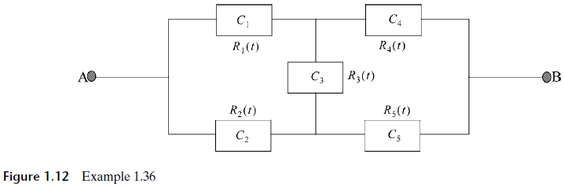
Examples
1.36 Find the system reliability function for the system shown in Figure 1.12, which is called a bridge structure.

Slide 9
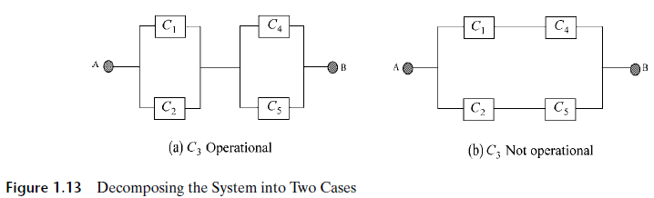

Examples
Solution: We use conditional probability approach. First, we consider the reliability function of the system given that $C_{3}$ is operational. Next we consider the reliability function of the system given that $C_{3}$ is not operational. Figure 1.13 shows the two cases.

Slide 10

Examples
When $C_{3}$ is operational, the system behaves like a parallel consisting of $C_{1}$ and $C_{2}$ which is in series with another parallel subsystem consisting of $C_{4}$ and $C_{5}$. Thus if we use the shorthand notation and omit the explicit dependence on $t$, the reliability of the system becomes
$$R_{X}=\left[1−\left(1−R_{1}\right)\left(1−R_{2}\right)\right]\left[1−\left(1−R_{4}\right)\left(1−R_{5}\right)\right]$$

Slide 11
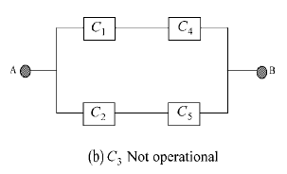

Examples
When $C_{3}$ is not operational, signal cannot flow through that component, and the system behaves as shown in Figure 1.13b. Thus, the reliability function of the system becomes
$$R_{Y}=1−\left(1−R_{1}R_{4}\right)\left(1−R_{2}R_{5}\right)$$

Slide 12
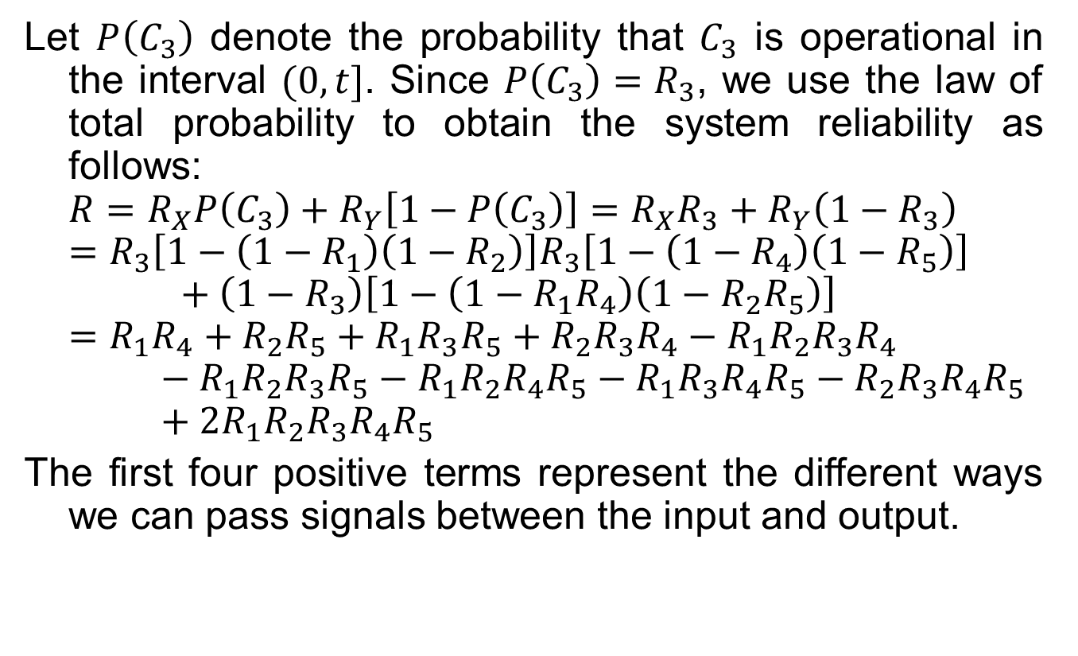
Examples
Let $P\left(C_{3}\right)$ denote the probability that $C_{3}$ is operational in the interval $(0, t]$. Since $P\left(C_{3}\right)=R_{3}$, we use the law of total probability to obtain the system reliability as follows:
$$R=R_{X}P\left(C_{3}\right)+R_{Y}\left[1−P\left(C_{3}\right)\right]=R_{X}R_{3}+R_{Y}\left(1−R_{3}\right)$$
$$=R_{3}\left[1−\left(1−R_{1}\right)\left(1−R_{2}\right)\right]R_{3}\left[1−\left(1−R_{4}\right)\left(1−R_{5}\right)\right]+\left(1−R_{3}\right)\left[1−\left(1−R_{1}R_{4}\right)\left(1−R_{2}R_{5}\right)\right]$$
$$=R_{1}R_{4}+R_{2}R_{5}+R_{1}R_{3}R_{5}+R_{2}R_{3}R_{4}−R_{1}R_{2}R_{3}R_{4}−R_{1}R_{2}R_{3}R_{5}−R_{1}R_{2}R_{4}R_{5}−R_{1}R_{3}R_{4}R_{5}−R_{2}R_{3}R_{4}R_{5}+2R_{1}R_{2}R_{3}R_{4}R_{5}$$
The first four positive terms represent the different ways we can pass signals between the input and output.

Slide 13
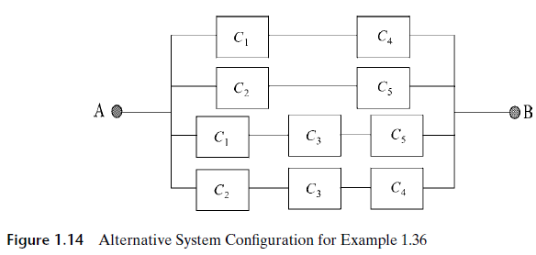
Examples
The equivalent system configuration is as shown in Figure 1.14.

Slide 14
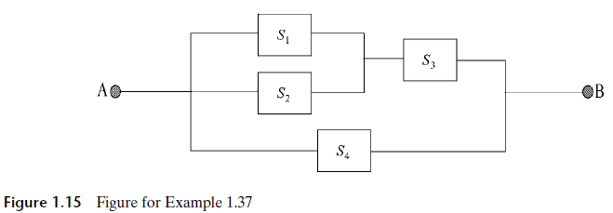

Examples
1.37 Consider the network shown in Figure 1.15 that interconnects nodes $A$ and $B$. The switches $S_{1}, S_{2}, S_{3},$ and $S_{4}$ have availabilities $A_{1}, A_{2}, A_{3}$ and $A_{4}$, respectively. That is, the probability that switch $S_{i}$ is operational at any given time is $A_{i}$, $i=1, 2, 3, 4$. If the switches fail independently, what is the probability that a randomly selected time $A$ can communicate with $B$ (that is, at least one path can be established between $A$ and $B$)?

Slide 15
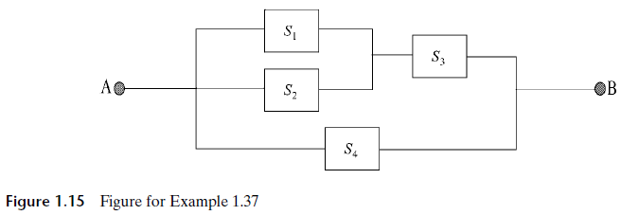

Examples
Solution:
We begin by reducing the structure as shown in Figure 1.14, where $S_{1−2}$ is the composite system of $S_{1}$ and $S_{2}$, and $S_{1−2−3}$ is the composite system of $S_{1−2}$ and $S_{3}$.

Slide 16
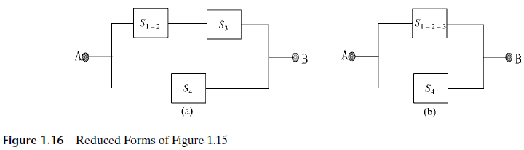

Examples
From Figure 1.16a, the availability of $S_{1−2}$ is $A_{1−2}=1−\left(1−A_{1}\right)\left(1−A_{2}\right)$. Similarly, the availability of $S_{1−2−3}$ is $A_{1−2−3}=A_{1−2}×A_{3}$. Finally, from Figure 1.16b, the probability that a path exists between $A$ and $B$ is given by
$$P_{A−B}=1−\left(1−A_{1−2−3}\right)\left(1−A_{4}\right)$$
$$=1−\left(1−\left[1−\left(1−A_{1}\right)\left(1−A_{2}\right)\right]A_{3} \right)\left(1−A_{4}\right)$$

Slide 17
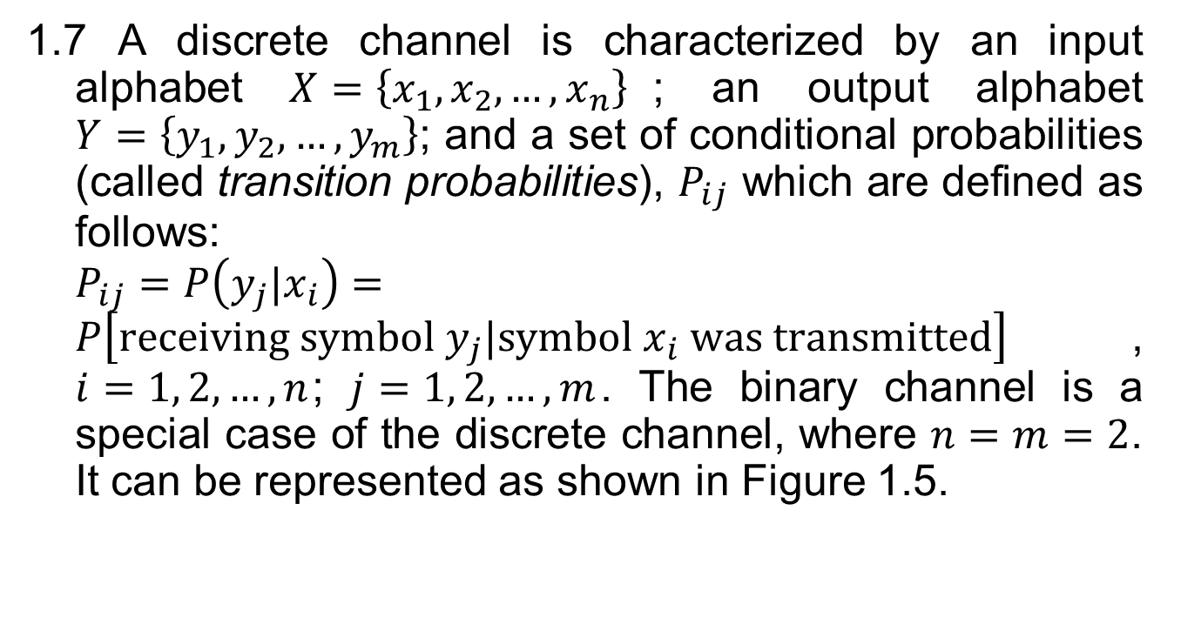
The Binary Symmetric Channel
1.7 A discrete channel is characterized by an input alphabet $X=\left\{x_{1}, x_{2},…,x_{n}\right\}$; an output alphabet $Y=\left\{y_{1}, y_{2},…, y_{m}\right\}$; and a set of conditional probabilities (called transition probabilities), $P_{ij}$ which are defined as follows: $P_{ij}=P\left(y_{j}|x_{i}\right)=P\left[receiving symbol y_{j}|symbol x_{i} was transmitted\right]$, $i=1, 2,…, n$; $j=1, 2,…,m$. The binary channel is a special case of the discrete channel, where $n=m=2$. It can be represented as shown in Figure 1.5.

Slide 18
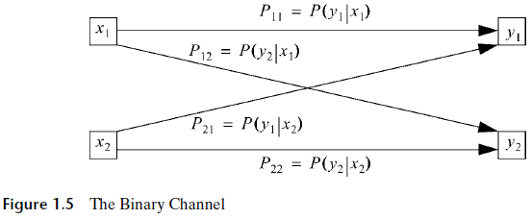
The Binary Symmetric Channel

Slide 19
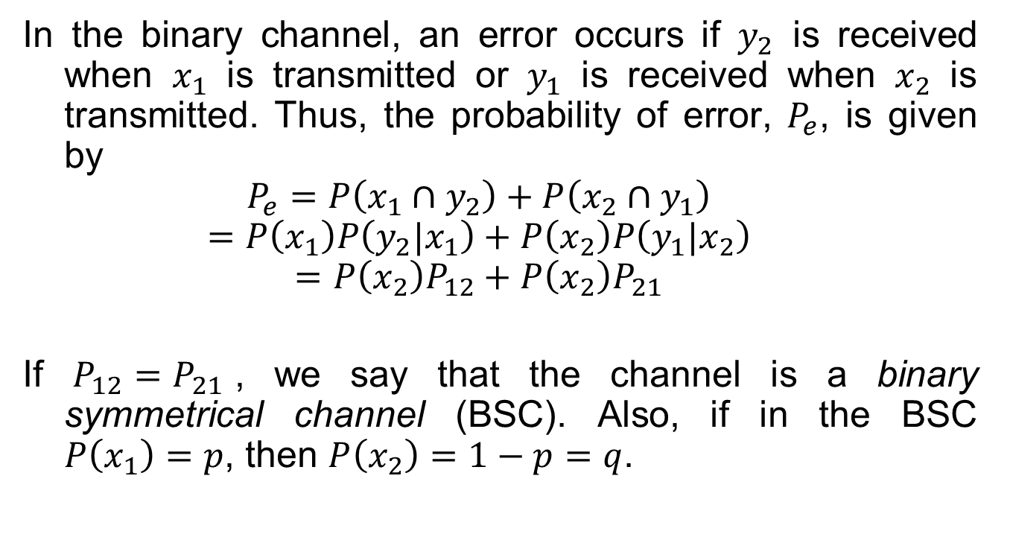
The Binary Symmetric Channel
In the binary channel, an error occurs if $y_{2}$ is received when $x_{1}$ is transmitted or $y_{1}$ is received when $x_{2}$ is transmitted. Thus, the probability of error, $P_{e}$, is given by
$$P_{e}=P\left(x_{1}∩y_{2}\right)+P\left(x_{2}∩y_{1}\right)$$
$$=P\left(x_{1}\right)P\left(y_{2}|x_{1}\right)+P\left(x_{2}\right)P\left(y_{1}|x_{2}\right)$$
$$=P\left(x_{2}\right)P_{12}+P\left(x_{2}\right)P_{21}$$
If $P_{12}=P_{21}$, we say that the channel is a binary symmetrical channel (BSC). Also, if in the BSC $P\left(x_{1}\right)=p$, then $P\left(x_{2}\right)=1−p=q$.

Slide 20
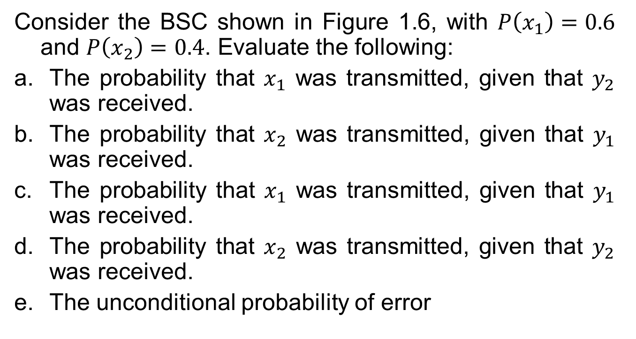
The Binary Symmetric Channel
Consider the BSC shown in Figure 1.6, with $P\left(x_{1}\right)=0.6$ and $P\left(x_{2}\right)=0.4$. Evaluate the following:
The probability that $x_{1}$ was transmitted, given that $y_{2}$ was received.
The probability that $x_{2}$ was transmitted, given that $y_{1}$ was received.
The probability that $x_{1}$ was transmitted, given that $y_{1}$ was received.
The probability that $x_{2}$ was transmitted, given that $y_{2}$ was received.
The unconditional probability of error

Slide 21
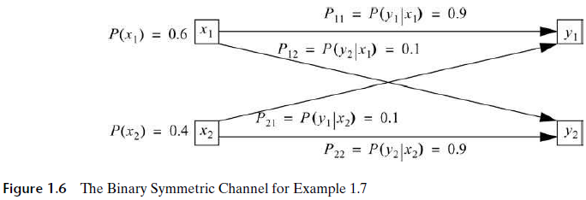
The Binary Symmetric Channel

Slide 22
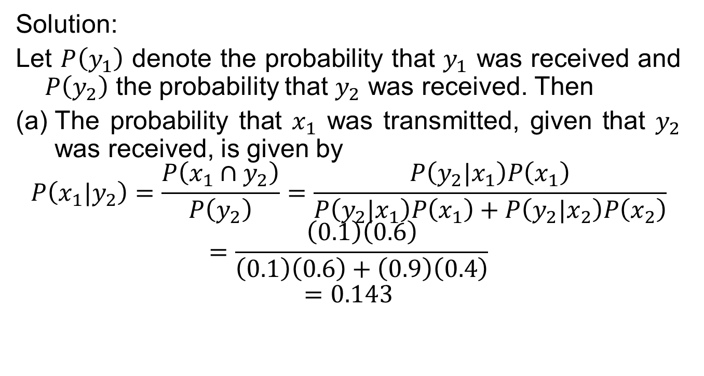
The Binary Symmetric Channel
Solution:
Let $P\left(y_{1}\right)$ denote the probability that $y_{1}$ was received and $P\left(y_{2}\right)$ the probability that $y_{2}$ was received. Then
The probability that $x_{1}$ was transmitted, given that $y_{2}$ was received, is given by
$$P\left(x_{1}|y_{2}\right)=\frac{P\left(x_{1}∩y_{2}\right)}{P\left(y_{2}\right)}=\frac{P\left(y_{2}|x_{1}\right)P\left(x_{1}\right)}{P\left(y_{2}|x_{1}\right)P\left(x_{1}\right)+P\left(y_{2}|x_{2}\right)P\left(x_{2}\right)}$$
$$=\frac{\left(0.1\right)\left(0.6\right)}{\left(0.1\right)\left(0.6\right)+\left(0.9\right)\left(0.4\right)}$$
$$=0.143$$

Slide 23
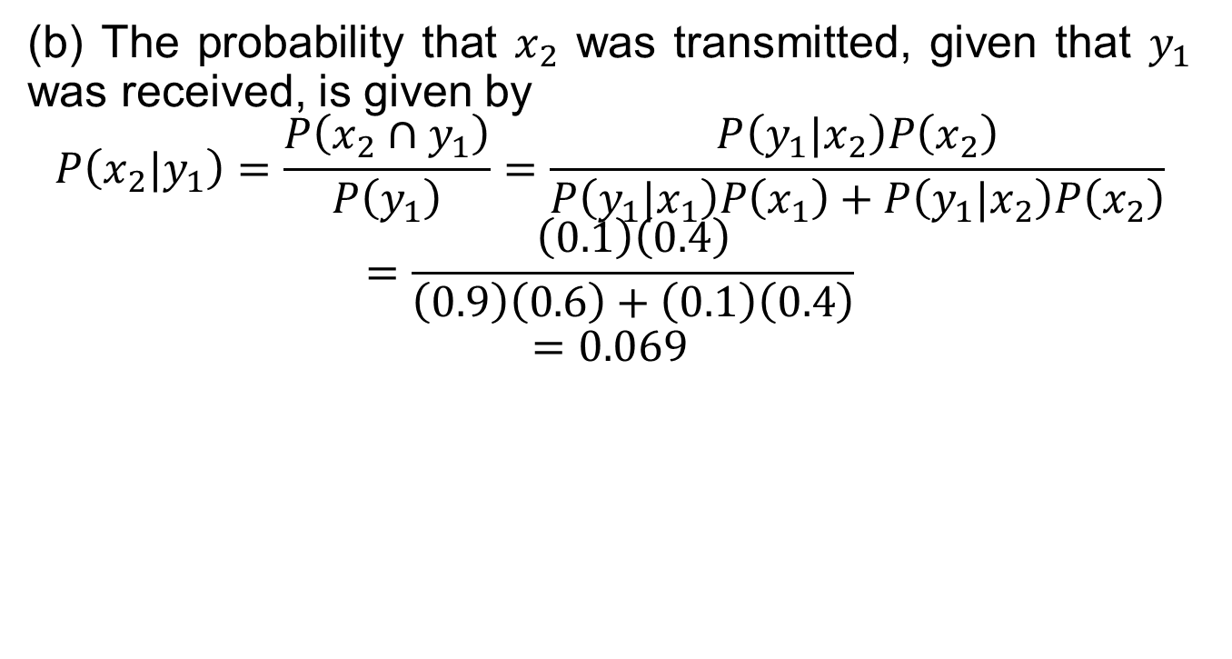
The Binary Symmetric Channel
(b) The probability that $x_{2}$ was transmitted, given that $y_{1}$ was received, is given by
$$P\left(x_{2}|y_{1}\right)=\frac{P\left(x_{2}∩y_{1}\right)}{P\left(y_{1}\right)}=\frac{P\left(y_{1}|x_{2}\right)P\left(x_{2}\right)}{P\left(y_{1}|x_{1}\right)P\left(x_{1}\right)+P\left(y_{1}|x_{2}\right)P\left(x_{2}\right)}$$
$$=\frac{\left(0.1\right)\left(0.4\right)}{\left(0.9\right)\left(0.6\right)+\left(0.1\right)\left(0.4\right)}$$
$$=0.069$$

Slide 24
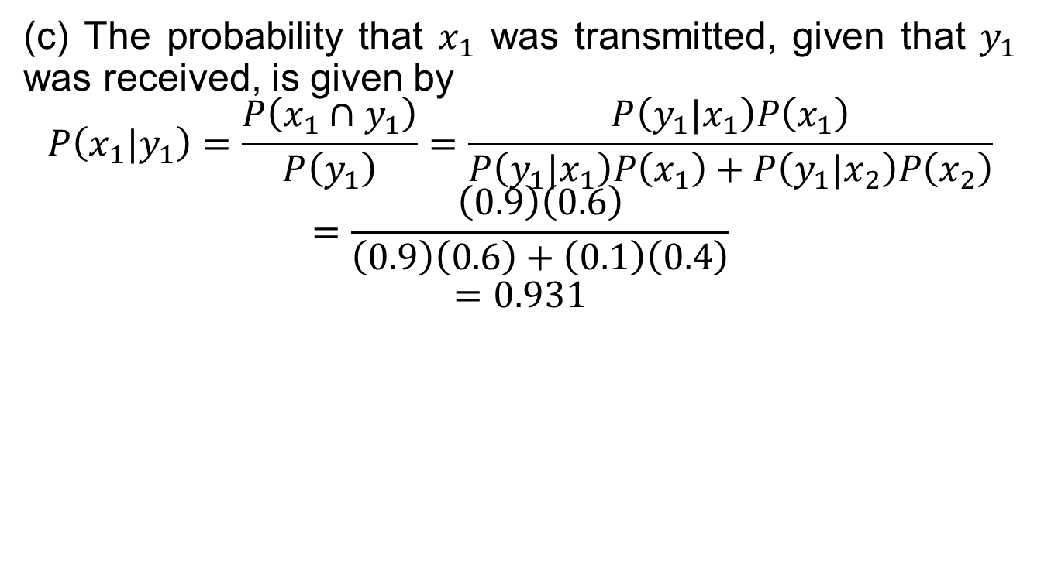
The Binary Symmetric Channel
(c) The probability that $x_{1}$ was transmitted, given that $y_{1}$ was received, is given by
$$P\left(x_{1}|y_{1}\right)=\frac{P\left(x_{1}∩y_{1}\right)}{P\left(y_{1}\right)}=\frac{P\left(y_{1}|x_{1}\right)P\left(x_{1}\right)}{P\left(y_{1}|x_{1}\right)P\left(x_{1}\right)+P\left(y_{1}|x_{2}\right)P\left(x_{2}\right)}$$
$$=\frac{\left(0.9\right)\left(0.6\right)}{\left(0.9\right)\left(0.6\right)+\left(0.1\right)\left(0.4\right)}$$
$$=0.931$$

Slide 25
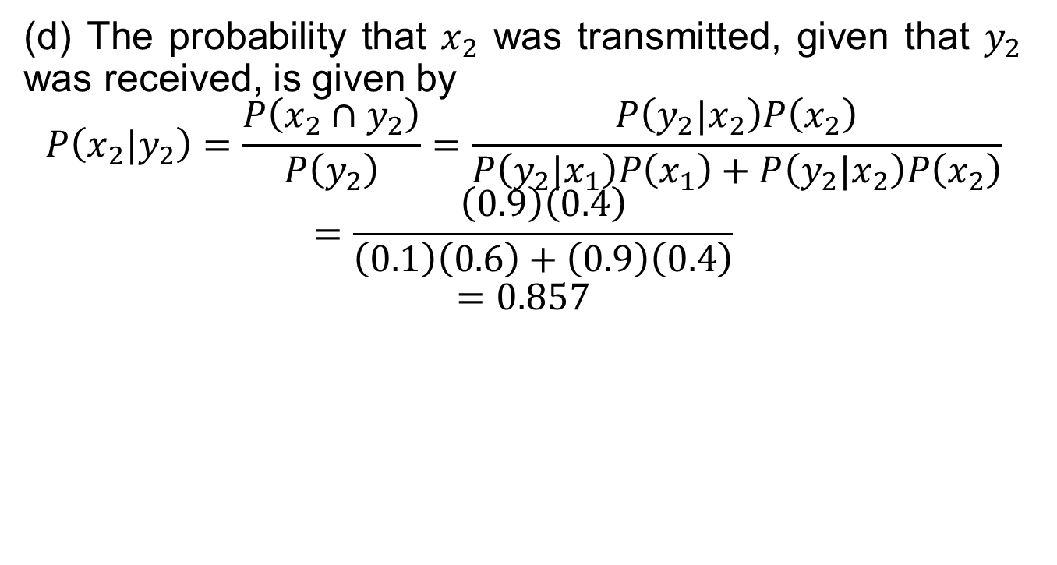
The Binary Symmetric Channel
(d) The probability that $x_{2}$ was transmitted, given that $y_{2}$ was received, is given by
$$P\left(x_{2}|y_{2}\right)=\frac{P\left(x_{2}∩y_{2}\right)}{P\left(y_{2}\right)}=\frac{P\left(y_{2}|x_{2}\right)P\left(x_{2}\right)}{P\left(y_{2}|x_{1}\right)P\left(x_{1}\right)+P\left(y_{2}|x_{2}\right)P\left(x_{2}\right)}$$
$$=\frac{\left(0.9\right)\left(0.4\right)}{\left(0.1\right)\left(0.6\right)+\left(0.9\right)\left(0.4\right)}$$
$$=0.857$$

Slide 26

The Binary Symmetric Channel
(e) The unconditional probability of error is given by
$$P_{e}=P\left(x_{1}\right)P_{12}+P\left(x_{2}\right)P_{21}$$
$$=\left(0.6\right)\left(0.1\right)+\left(0.4\right)\left(0.1\right)$$
$$=0.1$$

